Slide 1
PROJECT TITLE: Med Pad
PIP2001 Capstone Project
Review-0
Batch Number: 205
Roll Number | Names
20211IST0023 | Hitesh .D
20211IST0026 | Sushmitha V
20211IST0020 | Shamitha R
Under the Supervision of,
Dr. Pallavi R
School of Computer Science and Engineering
Presidency University
Name of the Program: Information Science and Technology
Name of the HoD: Dr. Pallavi R
Name of the Program Project Coordinator: Prof. Srinivas Mishra
Name of the School Project Coordinators: Dr. Sampath A K / Dr. Abdul Khadar A / Mr. Md Ziaur Rahman

Slide 2
Content
Problem Statement
Analysis of Problem Statement
Timeline of the Project
References

Slide 3
Problem Statement :
Organization: Dr. Reddy’s Labs
Category (Hardware / Software / Both) : Software
Problem Description:
→ Med Pad is a one stop solution consisting of all tools which can help a Medical Representative work with a lot more efficiency and yield better results.

Slide 4
Problem Statement
→ Med Pad is an application expected to be used by Medical Representatives to perform their daily word.
→Med Pad plays a crucial role in enhancing a pharmaceutical company’s sales.
Difficulty Level : Intermediate

Slide 5
Analysis of Problem Statement
Workflow:
Login
Check Recommendations
Access Marketing Materials
Video Conference
Collect Feedback
Knowledge Test
Performance Review

Slide 6
Analysis of Problem Statement
Software Components:
FRONTEND : HTML, CSS, JavaScript ,React.js
BACKEND : Node.js , Django (Python)
MICROSERVICES : Docker for containerization.
DATABASE : Mongo DB.
RESTFUL API : Integration and communication between front end and backend.
ML RECOMMENDATION SYSTEM : Python for building machine learning models (e.g., using scikit-learn, Pandas and numpy )for data analysis.
VIDEO CONFERENCING :Zoom API

Slide 7
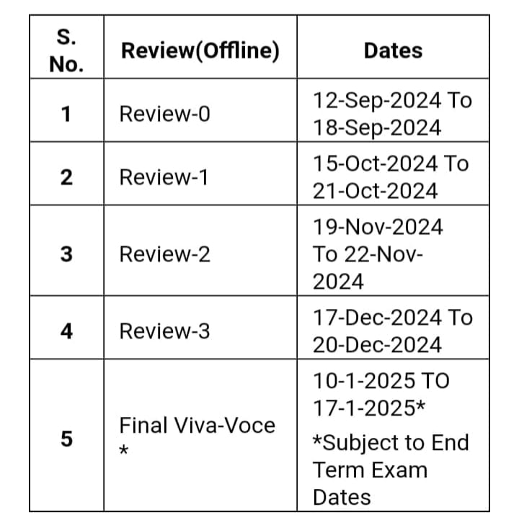
Timeline of the Project (Gantt Chart)

Slide 8
References
https://www.drugs.com/news.html

Slide 9


